Slide 1
Marketing and Predictive Analytics using Big data
Presenter: Ali Akbar Fani

Slide 2
Overview
1. Introduction
2. Why Marketing is important?
3. How bigdata is revolutionizing marketing and sales
4. Analytical Models
5. Predictive Analytics
6. Sales improvement using Predictive Analytics
7. Business Application of Predictive Analytics
8. Future Trends

Slide 3
Introduction
We all know what data is right? Data is information collected in one way or another, which is then stored for analysis in an aptly named database.
Back in the day, data could be something as simple as going door to door with questionnaires, which could still be the case, but now we tend to use technology to gather data. We slowly moved away from the pen and paper towards online data gathering and storage methods, which then also slowly evolved.
Now that the whole world is connected, servers are faster than ever, and pretty much everybody has internet, there is lots of data going around. There are literally thousands of terabytes of data to be collected and analyzed each day. This is where big data comes into play.
Bigdata, as the name implies, does refer to how much data there is, or in other words, the sheer amount of it from millions of people, but there is more to it than that.
Big data does refer to the quantity of data, but also to the variety of data. Big data comes in structured forms such as numeric info as well as unstructured data from things like financial transactions, videos, images, text documents, emails, and yes of course, from social media. Big data also refers to the fact that there is such a huge quantity of data that needs to be analyzed in near real time conditions, which can definitely be challenging.

Slide 4
Why Marketing is important ?
It Informs
1. Solid understanding of product
2.Consumer Education
It Sustains
1 Maintain healthy relationship
2 Business Flourish
It Engages
It Sells
1 Customer engagement outside store
2 Form a bond with brand
It Grows
1. Sell your product and Service
2. Business to make money
2. Spread word to new Customers
1. Growth of business

Slide 5
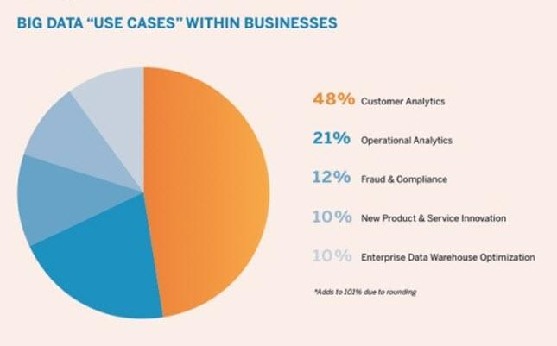
How bigdata is revolutionizing marketing and sales
This is our focus

Slide 6
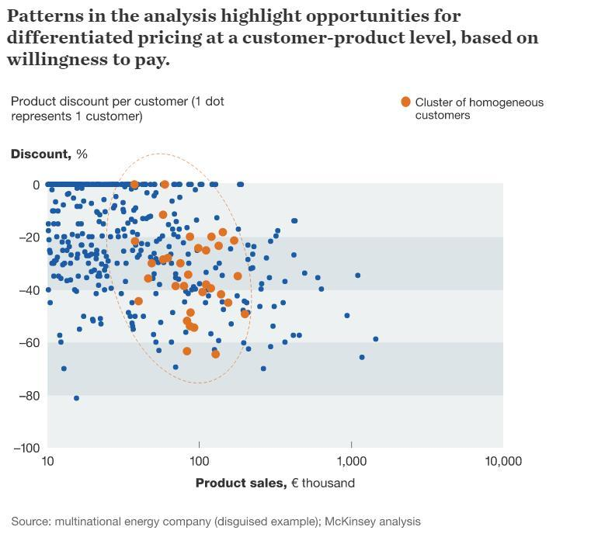
How bigdata is revolutionizing marketing and sales cont.

Slide 7

How bigdata is revolutionizing marketing and sales contd.
More relevant content: In the same way that Netflix can serve up personalized recommendations, publishers will be able to serve up more relevant content to their visitors by tapping into their wealth of data to determine which content people are most likely to enjoy.
Even content marketers will be able to get into the job, and digital marketers will need to learn to stop thinking of their blog as a static site. In the same way that you get different results when you Google the same phrase in different locations, your blog should look different depending upon who's looking at it.

Slide 8
Analytics Models
How can we make it happen?
What will happen?
Prescriptive Analytics
Why did it happen?
Predictive Analytics
Optimization
VALUE
Diagnostic
Analytics
What happened?
Descriptive Analytics
Hindsight Insight Foresight
Information
-----→We are here
1950
1990
2000
2018
2025

Slide 9
Predictive Analytics
Defining
Objectives
Focused on interpreting existing data.
Identifying cause-effect relationships
Discover hidden insights and patterns
Apply observed patterns to unknowns
Includes variety of statistics technique
Data mining
Text analytics
Predictive modeling
Predictive
Analytics
Process
Modeling
Monitoring
Data
Preparation
Deployment
Modeling

Slide 10

Sales Improvement using Predictive Analytics
Understand the market condition
Retaining Customer
Making right offer at right time
Upselling and Cross-Selling New Products

Slide 11
Business Application of Predictive Analytics
Supply Chain: Simulate and Optimize supply chain flows to reduce inventory
Customer Profiling: Identify high valued Customers and retain loyalty
Renewable Energy: Energy Forecasting, Predictive Maintenance
E- Commerce: Identify cross-sell and upsell opportunities, increase transactions.
Healthcare: Identify prevalence of particular disease to patient based health conditions.

Slide 12
Future trends
Amount of available data continues to grow, companies are looking for ways to keep up.
Many organization turning to Artificial Intelligence.
Machine learning, deep learning and Natural processing to automate overwhelming amount of information.
Amazon and Facebook have the capacity to filter through all data.

Slide 13
References
https://bigdata-madesimple.com/5-examples-predictive-analytics-travel-industry/
https://Netflix.com
https://www.mni.com/future-of-big-data-digital-marketing.html
https://developer.ibm.com/recipes/tutorials/impact-of-big-data-on-social-media-marketing-strategies/
https://movingtargets.com/blog/business/why-marketing-is-so-important/
https://blog.reachforce.com/blog/5-ways-to-use-predictive-analytics-to-support-sales
https://vortini.com/blog/forecasting-predictive-analytics/
https://www.qubole.com/blog/big-data-marketing/

Slide 14
Thank You!

